Slide 1




UNITE Program POC Training
Jarrod Garceau
Community Cohesion Coordinator
Thomas Coleman
Chief, Community Services Flight

Slide 2
Breakdown
What is UNITE?
UNITE is one of the 4 legs of the R4R program (Recharge 4 Resiliency)
The UNITE program is a tool for commanders and leadership to take care of their Airmen by giving them a funded recreational opportunity to build unit cohesion and Esprit de corps.
The Community Cohesion Coordinator (C3) oversees the UNITE program.
The C3 works with commanders, leadership, and POCs in the submission process to AFVSC for funding.
Events must be both recreational and unit cohesive to utilize Unite funds.

Slide 3
Who benefits from UNITE
This program will benefit all Airmen in a unit; Active, Reserve, and Civilian (appropriated and non-appropriated employees) directly assigned.
Does not include Family Members and any one not mentioned above.

Slide 4
Funding
NAF Dollars (Food Funds): $5/person Food and beverage Must be used with a UNITE event. One beverage limit per meal.
No alcohol.
NAF cannot be used for items to prepare food, charcoal, utensils, plates/containers
APF (MOA) Dollars (Activity Funds): $13.50/person Equipment rentals, program supplies, decor, and entertainment.
If a squadron has 100 total people with days, mids, and nights workers. They have a program asking for $1350 in APF and $500 in food but mids and nights can’t attend. Is this authorized?
NO. Funding is based on those attending.
Same Squadron hosts 3 events during the day only and mids/nights can’t attend. Is this authorized?
NO. Every Airmen is entitled to their fair share of UNITE funds.

Slide 5
Funding
The UNITE program is activity-based, and NAF dollars are an added benefit. NAF funds must be directly in conjunction with an approved UNITE event. An event centered on just eating without an approved Unite cohesive and or team building event is NOT authorized and will not be approved.
UNITE funds are NOT to use for the following: holiday parties, end of year events, balls, banquets, dining in/out, combat dining in/out, squadron training/meetings, change of commands, promotion/retirements, base-wide special events, or purchase movie tickets to attend a movie theatre.

Slide 6
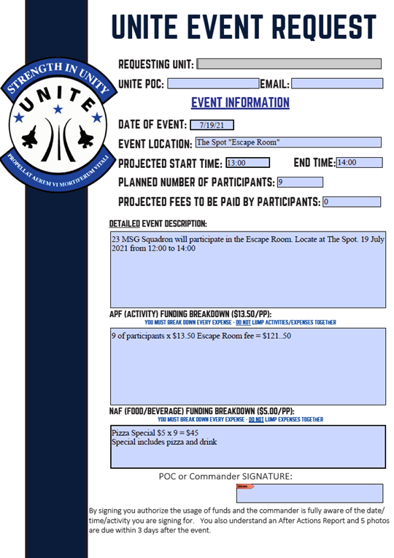
Request Funding
Only a commander, 1st Sgt, SEL or a trained POC can request funds.
State a detailed plan
Work with C3 to make sure we can maximize on program value and cost
Get commander/leadership buy in
Get Airmen buy in
Be aware of timelines
Plan ahead
Attach invoices and vendor contact info

Slide 7
Request Funding
We are going Bowling
We will have pizza
We will have a BBQ
Will have Ax throwing
How a submission should look:
555 Squadron will have a Bowling Pizza Party 15 Sept from 10:00- 12:00. Bowling and shoe rental is $13.50 x 100 Airmen = $1350 is requested
Pizza is $5 x 100 Airmen = $500
555 Squadron will have a Ax Throwing and BBQ outing at Mission Lake. 100 Airmen will be attending
Ax rental from ODR for 3 hours= $500
Ribs, Burgers, Hotdogs, Mac & Cheese, and potatoes will be bought at the commissary for $500

Slide 8
Approval
C3 reviews request and makes sure it meets UNITE guidance.
Does it have a recreational element
Are the Airmen going to have fun?
C3 is not committed to off base contracts or payments
Requests are submitted to Headquarters in Texas
SOLE approval lies with AFSVC
UNITE is Air Force money and is subject to audit.
Can take up to 10 days to receive approval
Once approved you will receive an email with your authorization and instructions

Slide 9
Payment
If on base: have your invoices attached to your request and the C3 pays for them the week of the event.
If you are going to the Commissary. Set up a time with the C3 the week of the event to pay for the event. (You can pre-order)
If off base have your invoices and a way to contact them attached to your request and the C3 pays for them the week of the event. (Make sure they are tax free)
C3 is not committed to off base payments that are not approved.
Be aware of holidays, down days, training days and weekends.

Slide 10
Having Fun
Ready to Execute
Programs that already are part of FSS and negotiated by the C3
Easiest to get approval and are usually very affordable
Bowling, Golf, Paintball, Club Catering, ODR rentals, Escape room, Ax Throwing
Get with FSS activity manager to find the program that fits you
Unit Developed
Programs made by the squadron
Usually meets a specific need of the squadron meeting UNITE guidelines
Free and Volunteer (Great bullet)
Charity work or something quick and fun that squadrons already do
Most underutilized and can help future funding

Slide 11
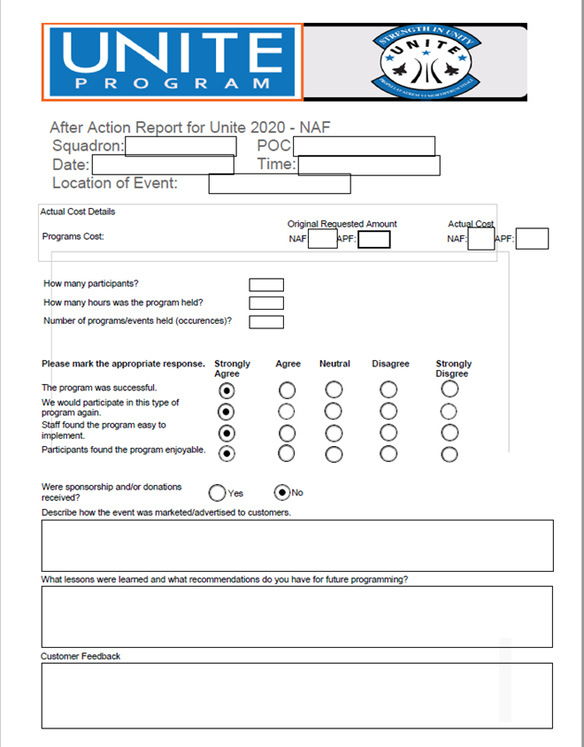
After Actions
After Actions are due 3 days after the event
After Actions include:
After Actions Report
At least 5 photos of the event
Photos are required to prove the event happened. If 100 Airmen are at this event there should be pictures showing 100 Airmen.
Do not embed photos in AAR
Future funding will be with held until After Actions have been turned in
Please reference UNITE Code
Non-Negotiable!

Slide 12
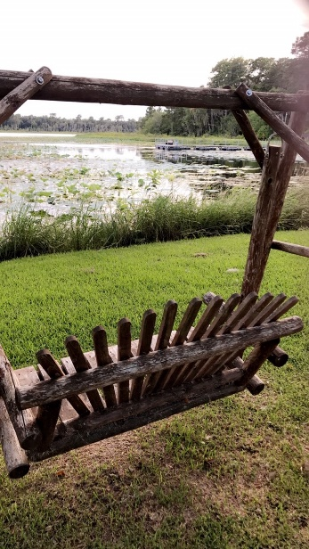
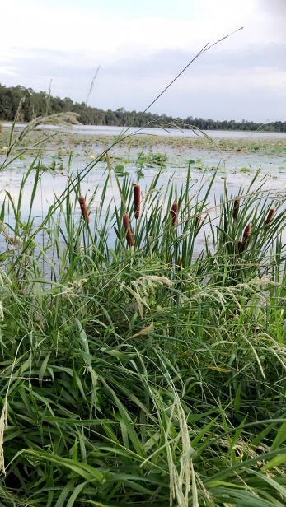
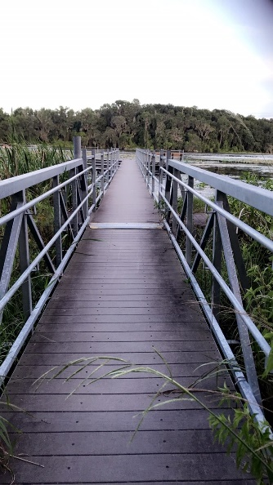
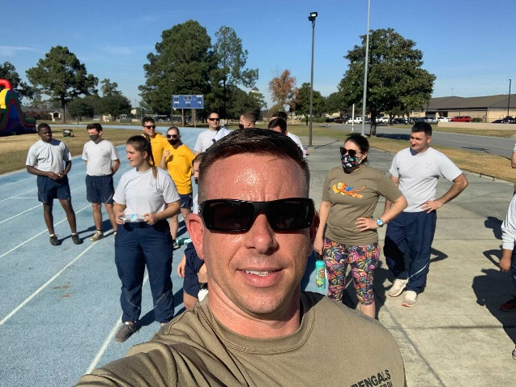
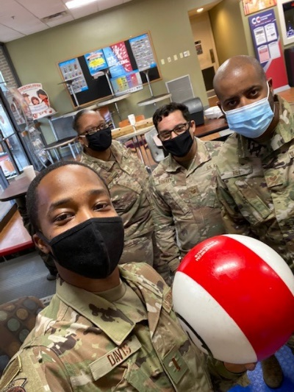
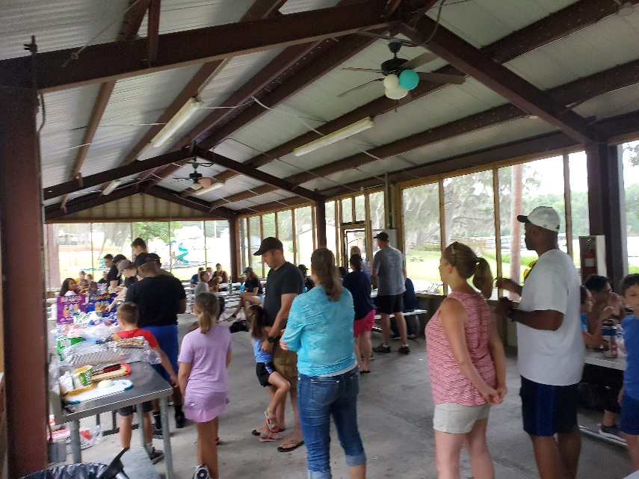
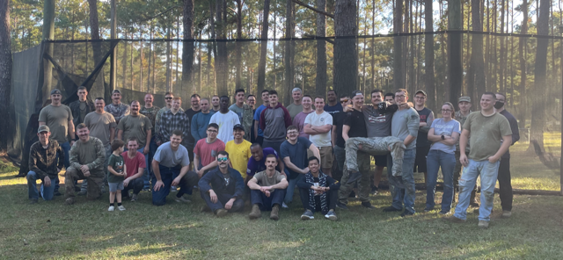
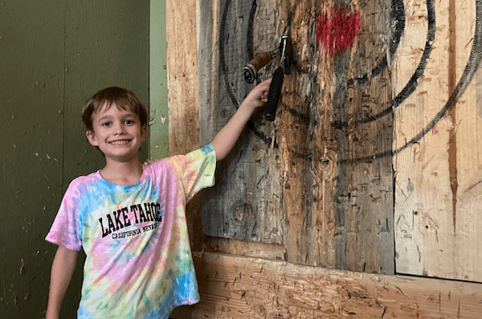
Unauthorized Photos Authorized Photos

Slide 13
NOTES
UNITE can not be combined with UNIT Enhancement or SM&W funds
Never delegate UNITE to an untrained person
It is prohibited to use a UNITE event as a Fundraiser
The UNITE office does not book the events we only pay for the events
UNITE event needs to be booked with activity manager
UNITE pricing is subject to availability
Purchases outside the base need Tax Free Paperwork
No freebies from ODR or other activities.(No 1st Sgt letter for free stuff)
A mid-year review (April/May timeframe) may be conducted to assess the installations’ execution of UNITE funds. AFSVC reserves the rights to realign funds based on allocation rates.

Slide 14
FAQ
Can we use UNITE for our annual holiday party?
No, Events held on or near Thanksgiving, Christmas, or New Year’s will not be approved. Holiday parties of any kind are not authorized for UNITE funds.
Can we just say it’s for something else ? (wink wink)
NO!
What happens to the money we do not spend?
Money not spent goes away and squadrons expenditures are reviewed at the Air Force level for next year.
We just want food for our event.
NO! UNITE is a recreational based program. You need to have a recreational program to be authorized to use food funding.
I need to cancel or move my event
Just let the C3 know as soon as possible

Slide 15
Excuses Not to use Funding
The Mission:
Airmen are the mission, UNITE is here to support the mission through teambuilding and integration
No Time:
Squadron Commander, 1st Sgt, Chiefs or Leadership can make time to improve their teams morale through a great event
No interest:
More reason to have a UNITE event

Slide 16
Questions
?

